Slide 1
Computer Vision CIS581-Final Project Checkpoint 1 Option 2
Face Detection
progress
12/03/2015
Jingling Li
Tianli Han

Slide 2
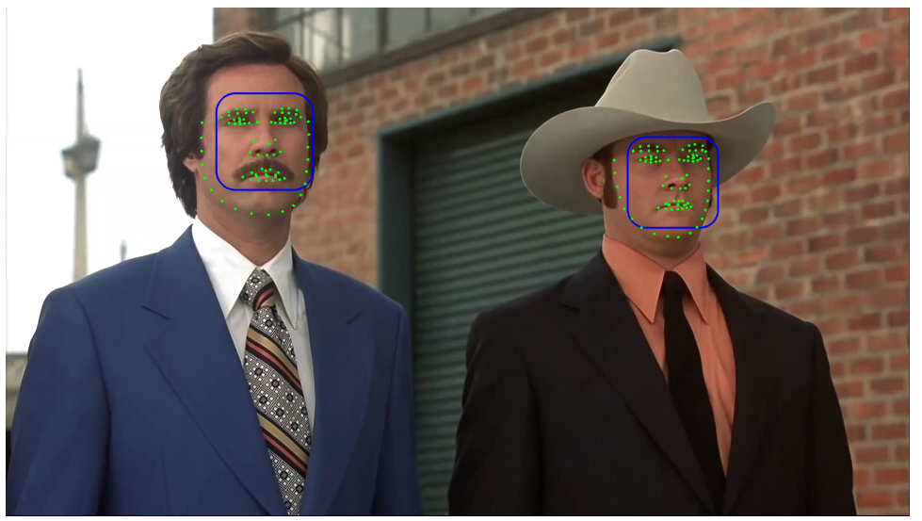
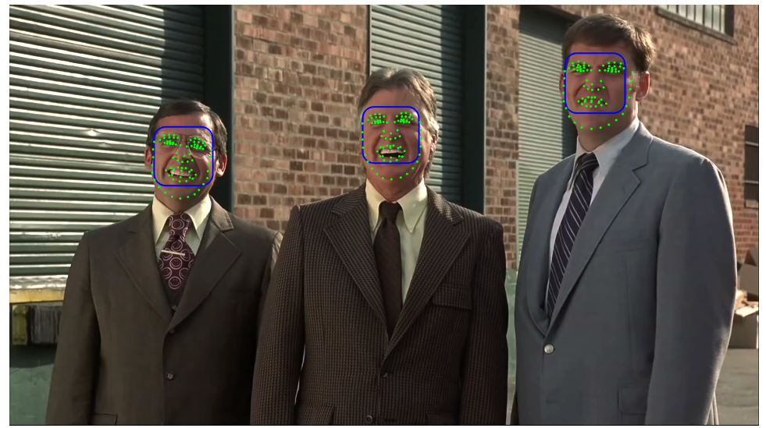
Picture from easy segments
Used Face++ API to detect faces and find facial landmarks
The results look very good on front poses
Face++ used large-scale machine learning, data mining to detect facial points along with other information in the image

Slide 3
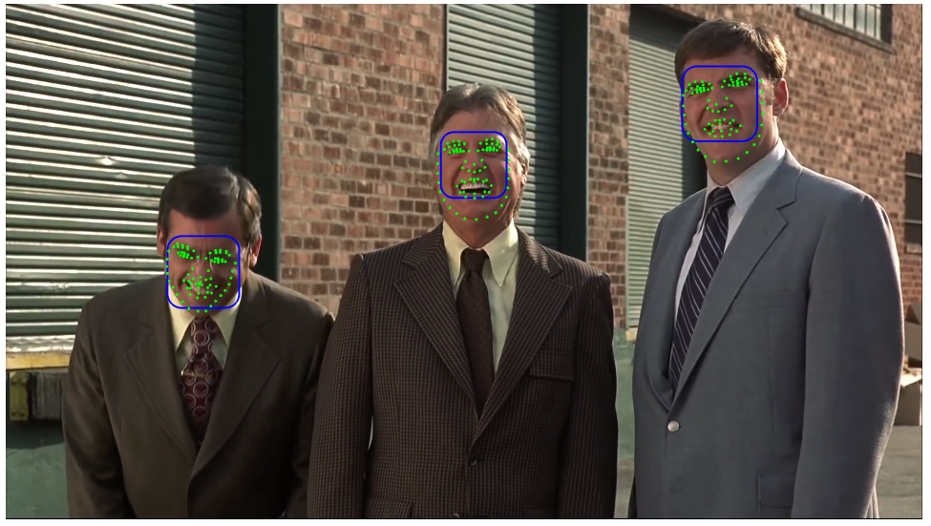
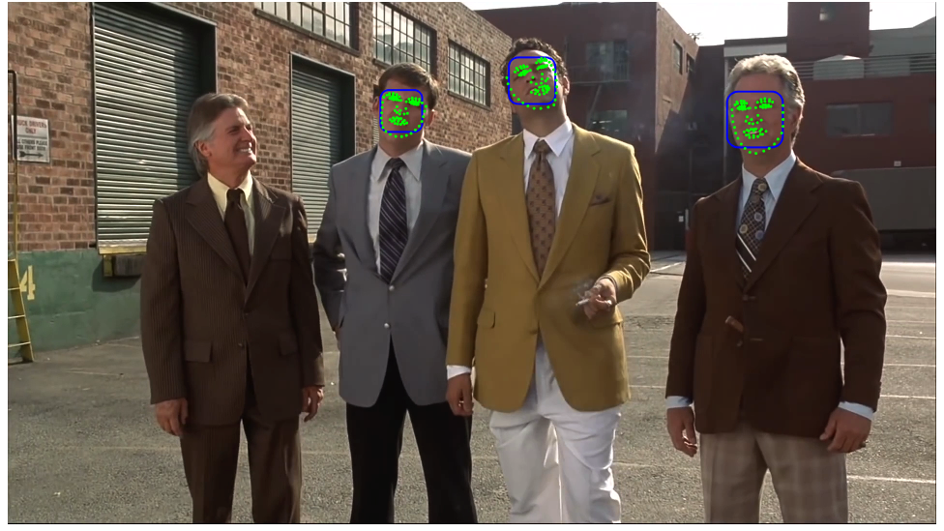
However, Face++ may not be able to detect faces at different poses (the lower image)
The facial landmarks are skewed for non-front poses as well
Therefore, we may need to write our own algorithm to find faces at different angles or use motion compensation to help the recognition results

